Slide 1
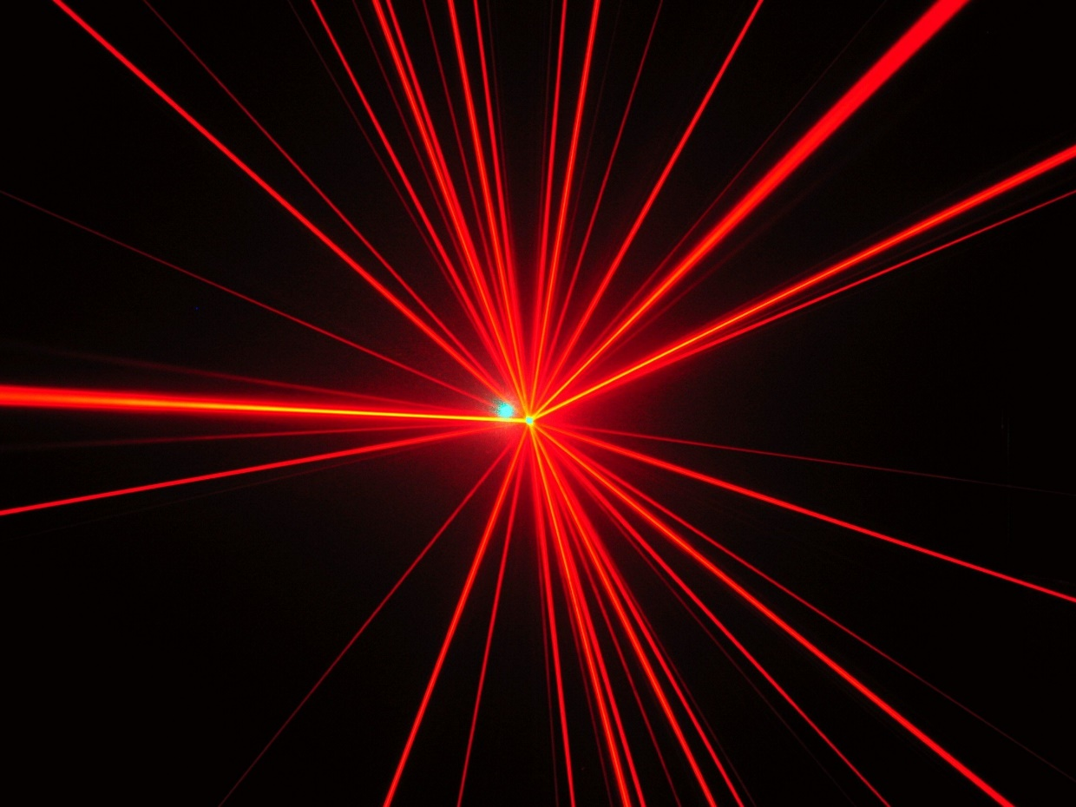
LASER GESTURE SENSING
MODULE

Slide 2
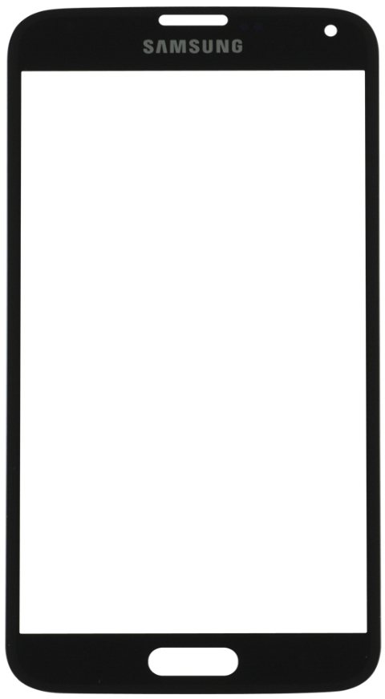
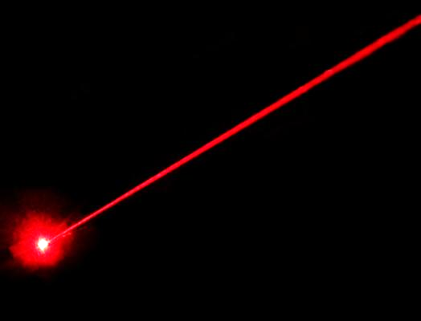
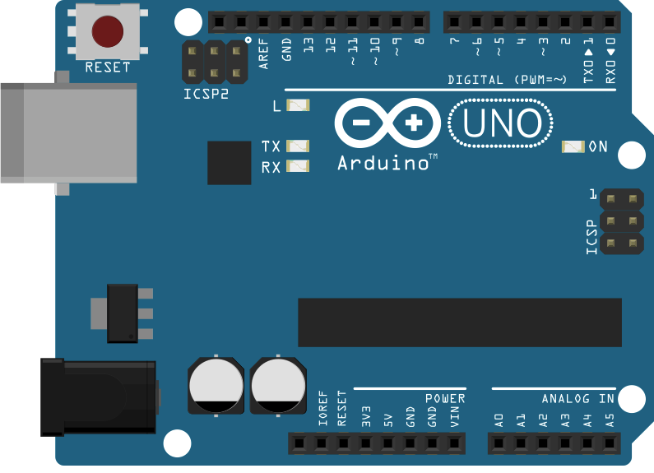
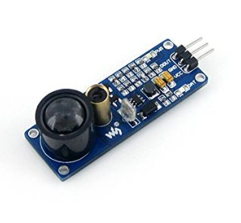

About the Model :
A gesture sensing module
using
LASER
and
Arduino
as the processing unit
with Bluetooth enabled
operation

Slide 3
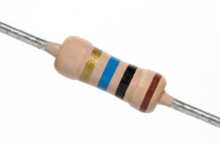
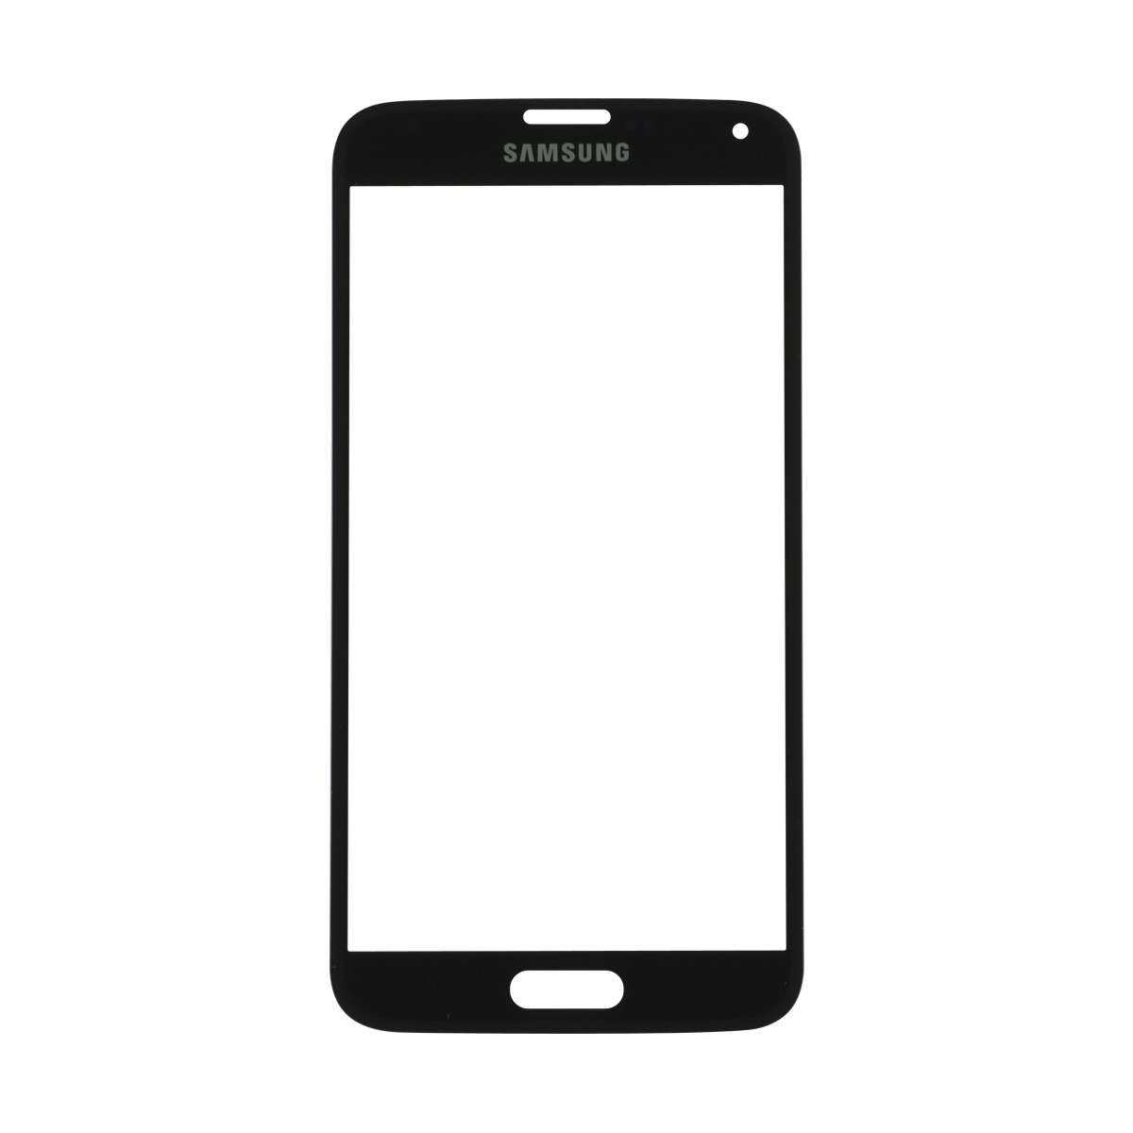
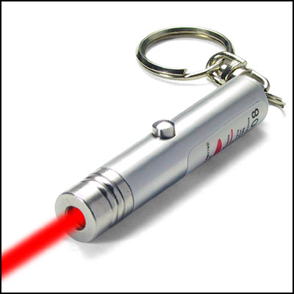
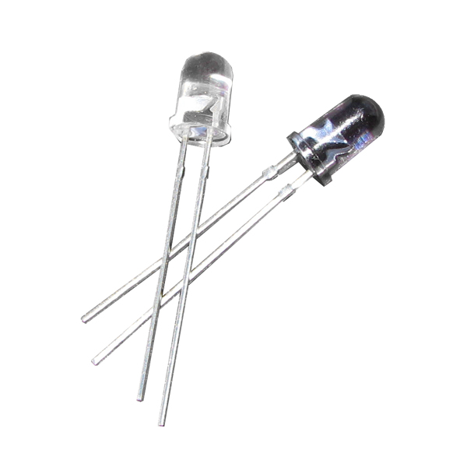
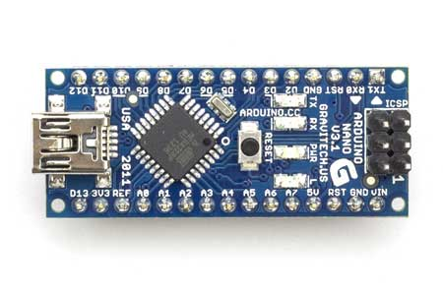
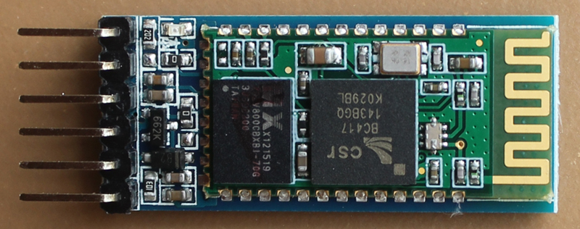

Apparatus Used :
Arduino NANO microcontroller board
2 Photodiodes
2 Resistors (3 KΩ)
2 LASER diodes
HC 05 Bluetooth communication module
Smartphone supporting Bluetooth connectivity

Slide 4
Circuit Diagram :
LASER
pointers
Arduino
A1
A0
D12
GND
Photodiode
Photodiode
Resistors (3 KΩ)

Slide 5
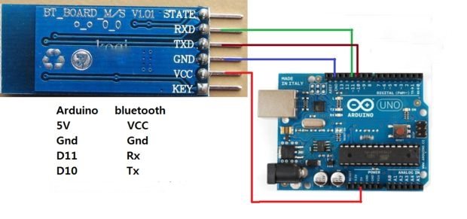
Arduino to Bluetooth connection:
D11
RX
The Android app on the smartphone receives signal from the HC 05 Bluetooth communication module and displays and speaks out the message interpreted.
D10
TX
VCC(5V)
PWR
GND
GND

Slide 6
Technology Used :
LASER-Photodiode pair module – Amplified light source projected towards the obstruction i.e. the gesture mechanism.
Microcontroller unit – Detects the gesture and gives the feedback on a smartphone via Bluetooth and a custom made app.

Slide 7





How it works :
NO
YES
SWIPED
LEFT
SWIPED
RIGHT

Slide 8
Utility and Benefits :
A simple and fast gesture sensing unit that is more precise than that of a camera’s sensory equipment for hassle free operation
Energy efficient and lesser computing power required
Simple to use, understand and teach others
Completely modular system with each component acting as individual units that can be replaced anytime, hence less maintenance
Portability, since the entire setup is extremely small to carry around along with the app on the smartphone, thus can be easily taken anywhere, anytime
Simple hand gestures can be converted into letters, words, phrases and sentences, thus enabling easy education and communication for audibly and/or verbally disabled people
An entire grid of such laser based array can be interpreted into numerous combinations of gestures that can highly enhance non-contact and non-verbal communication

Slide 9
Entrepreneurship Potential :
Currently in its primitive phase and has widespread application field.
Due to the use of LASER and photodiodes, it is extremely responsive and accurate to be modified into further advanced devices.
The entire setup is extremely simple to build and is also cost efficient. Thus, implementing into advanced sensory devices.

